Slide 1
AWS Serverless
Amazon Web Services

Slide 2
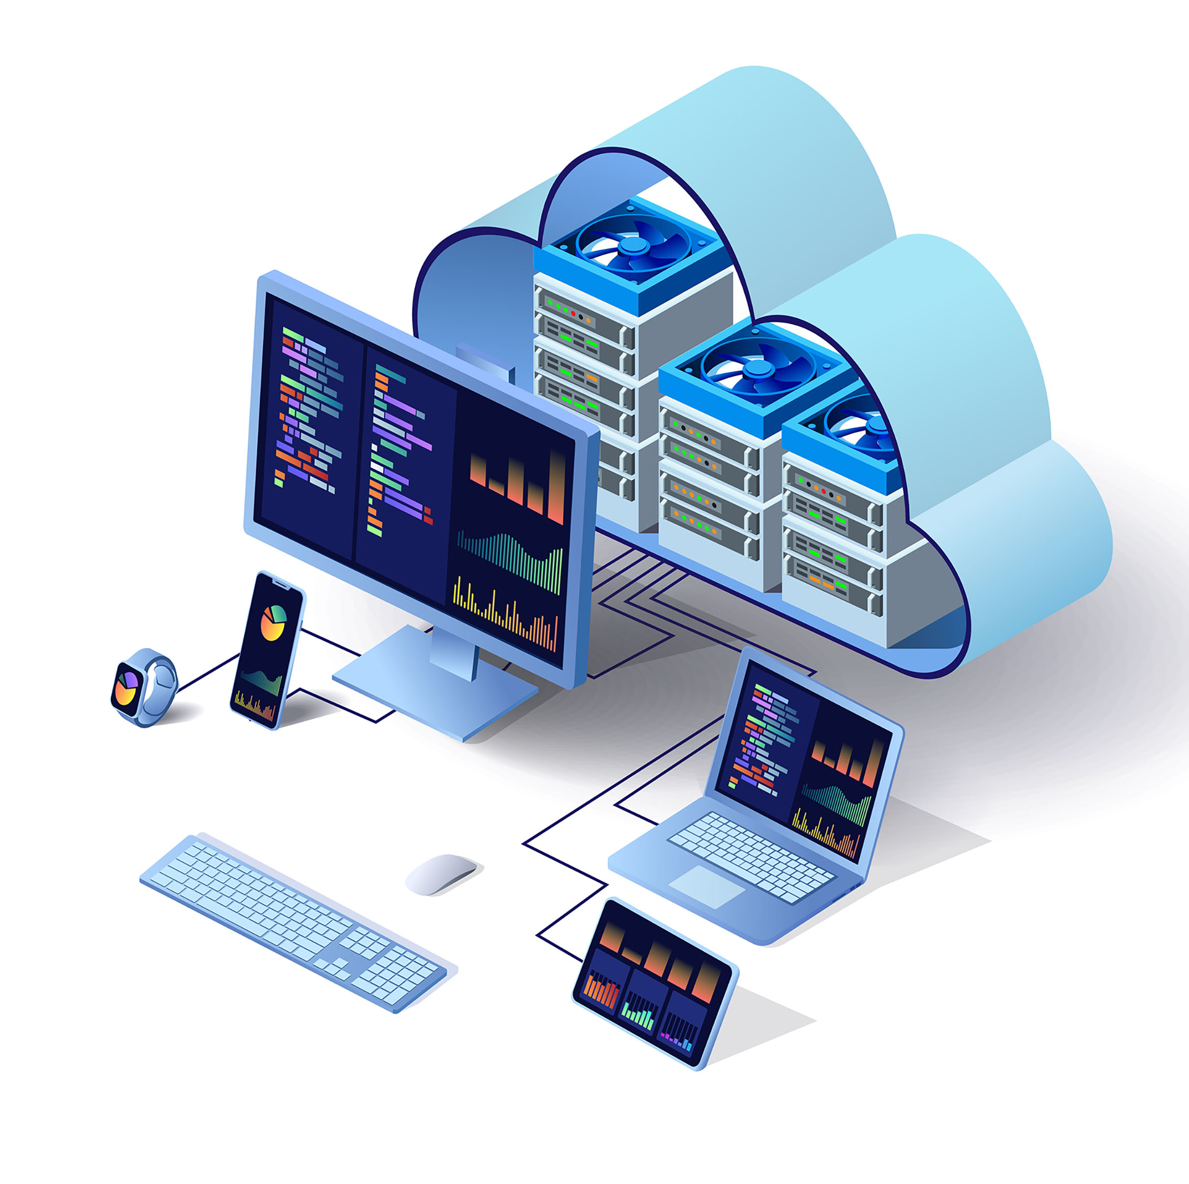
Benefits of Cloud Infrastructure
Full Control comes with responsibilities:
Manage your resources – security patching, updates
Designing for high-availability
Designing for scalability
Configure access based on principle of least privilege
Configure and implement data encryption

Slide 4
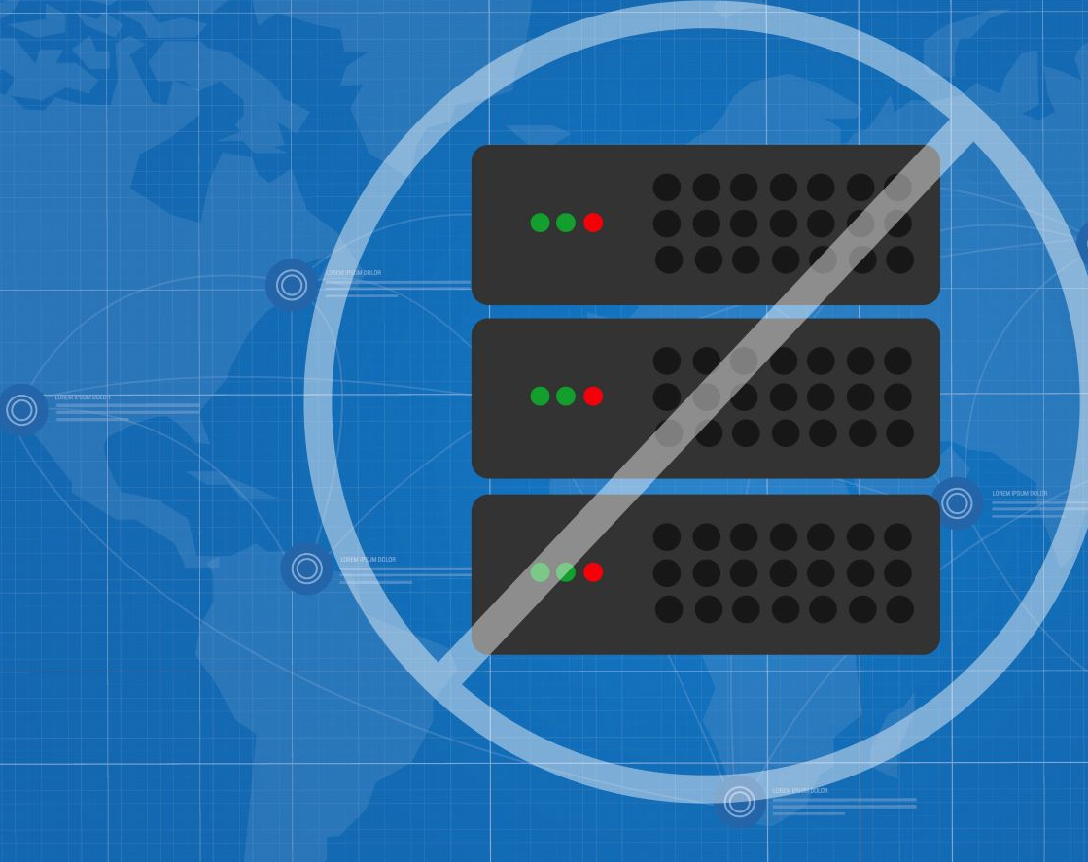
Introducing AWS Serverless
Serverless architectures abstracts the management and maintenance of servers away from the customer

Slide 5
AWS Serverless
With AWS Serverless, you can use technologies for running code, managing data, and integrating applications, all without having to manage, scale or secure servers.
Automatic scaling
Built-in high availability
Consumption model – you pay for what you use, when you use
Increase agility
Reduces operational overhead and management as there is no need to patch, update services.

Slide 6







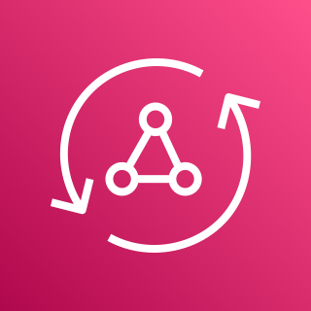


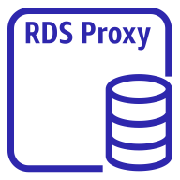

AWS offers various serverless services to help build typical three-tier application stacks.
Compute Layer
AWS Fargate
AWS Lambda
Application Integration Layer
Amazon Simple Queue Service (Amazon SQS)
AWS Step Functions
Amazon EventBridge
Amazon Simple Notification Service (Amazon SNS)
Amazon API Gateway
AWS AppSync
Data store
Amazon Simple Storage Service (Amazon S3)
Amazon DynamoDB
Amazon RDS
proxy instance
Amazon Aurora Serverless

Slide 7

Control vs Convenience
Instance
AWS Fargate

Slide 8
Next Video
AWS Lambda

